Slide 1
Bubble Sort
It is a sorting algorithm that compares two adjacent elements and swaps them until they are in the intended order.
Working of Bubble Sort
E.g.: to sort the elements in ascending order.
1. First Iteration (Compare and Swap):
Starting from the first index, compare the first and the second elements.
If the first element is greater than the second element, they are swapped.
Now, compare the second and the third elements. Swap them if they are not in order.
The above process goes on until the last element.

Slide 2
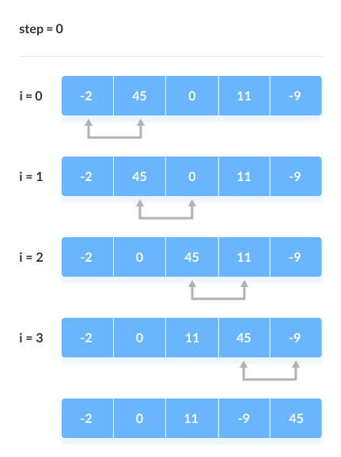
Contd…
Fig: Compare the Adjacent Elements

Slide 3
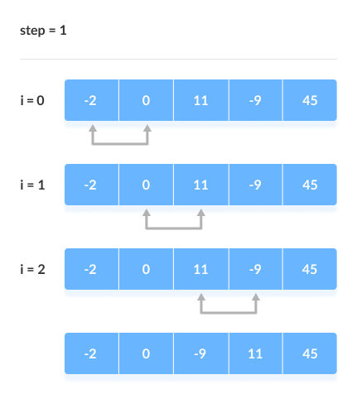
Fig: Put the largest element at the end
2. Remaining Iteration
The same process goes on for the remaining iterations.
After each iteration, the largest element among the unsorted elements is placed at the end.

Slide 4
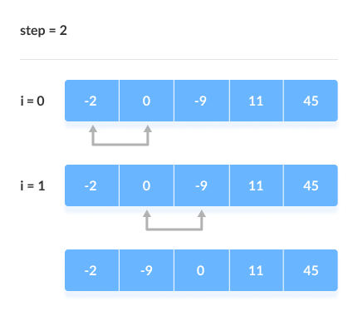
In each iteration, the comparison takes place up to the last unsorted element.
Fig: Compare the adjacent elements

Slide 5
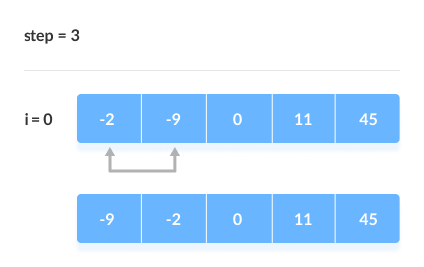
The array is sorted when all the unsorted elements are placed at their correct positions.

Slide 6
Bubble Sort Algorithm
bubbleSort(array)
for i =0 to indexOfLastUnsortedElement-1
if leftElement > rightElement
swap leftElement and rightElement
end bubbleSort

Slide 7
Bubble sort in Python:
def bubbleSort(array):
# loop to access each array element
for i in range(len(array)):
# loop to compare array elements
for j in range(0, len(array) - i - 1):
# compare two adjacent elements
if array[j] > array[j + 1]:
# swapping elements if elements are not in the intended order
temp = array[j]
array[j] = array[j+1]
array[j+1] = temp
data = [-2, 45, 0, 11, -9]
bubbleSort(data)
print('Sorted Array in Ascending Order:')
print(data)

Slide 8
Optimized Bubble Sort Algorithm:
In the previous algorithm, all the comparisons are made even if the array is already sorted.
To solve this, we can introduce an extra variable ’swapped’. The value of swapped is set true if there occurs swapping of elements. Otherwise, it is set false.
After an iteration, if there is no swapping, the value of swapped will be false. This means elements are already sorted and there is no need to perform further iterations.
This will reduce the execution time and helps to optimize the bubble sort.

Slide 9
Algorithm for optimized bubble sort:
bubbleSort(array)
swapped <- false
for i = 0 to indexOfLastUnsortedElement-1
if leftElement > rightElement
swap leftElement and rightElement
swapped <- true
end bubbleSort

Slide 10
Optimized Bubble sort in Python
def bubbleSort(array):
# loop through each element of array
for i in range(len(array)):
# keep track of swapping
swapped = False
# loop to compare array elements
for j in range(0, len(array) - i - 1):
# compare two adjacent elements
# change > to < to sort in descending order
if array[j] > array[j + 1]:
# swapping occurs if elements are not in the intended order
temp = array[j]
array[j] = array[j+1]
array[j+1] = temp
swapped = True

Slide 11
Contd…
# no swapping means the array is already sorted
# so no need for further comparison
if not swapped:
break
data = [-2, 45, 0, 11, -9]
bubbleSort(data)
print('Sorted Array in Ascending Order:')
print(data)

Slide 12
Number of comparisons is (n-1) + (n-2) + (n-3) +.....+ 1 = n(n-1)/2 Bubble Sort Complexity
1. Time Complexities:
Worst Case Complexity: O(n²)
Best Case Complexity: O(n)
Average Case Complexity: O(n²)

Slide 13
Applications:
Bubble sort is used if
complexity does not matter
short and simple code is preferred

Slide 14
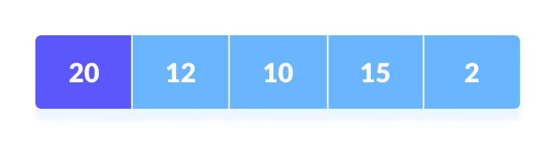
Selection Sort Algorithm
It is a sorting algorithm that selects the smallest element from an unsorted list in each iteration and places that element at the beginning of the unsorted list.
Working of Selection Sort
1. Set the first element as minimum.

Slide 15
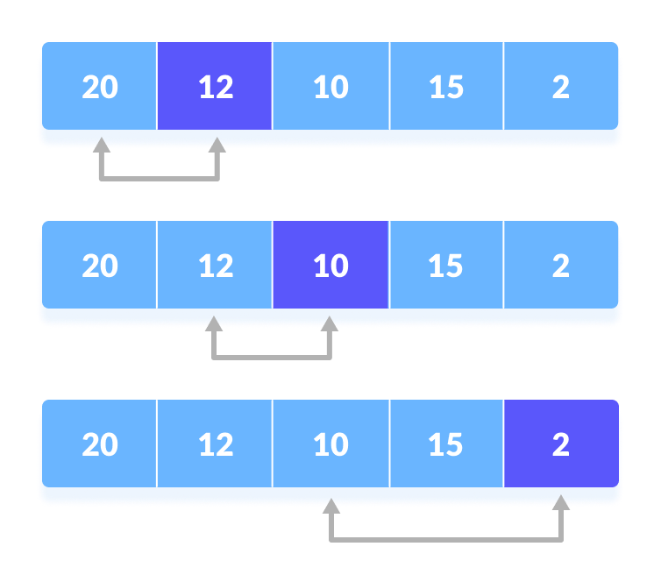
Contd…
2. Compare minimum with the second element. If the second element is smaller than minimum, assign the second element as mimum.
Compare minimum with the third element. Again, if the third element is smaller, then assign minimum to the third element otherwise do nothing. The process goes on until the last element.

Slide 16
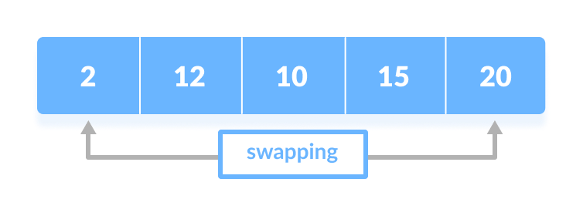
Contd… 3. After each iteration, minimum is placed in the front of the unsorted list.

Slide 17
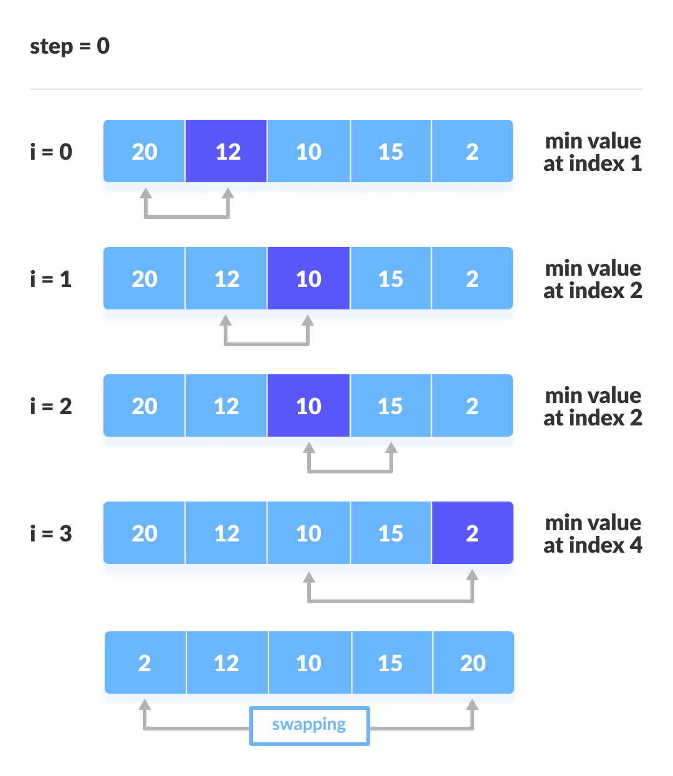
Contd… 4. For each iteration, indexing starts from the first unsorted element. Step 1 to 3 are repeated until all the elements are placed at their correct positions.
Fig: The first iteration

Slide 18
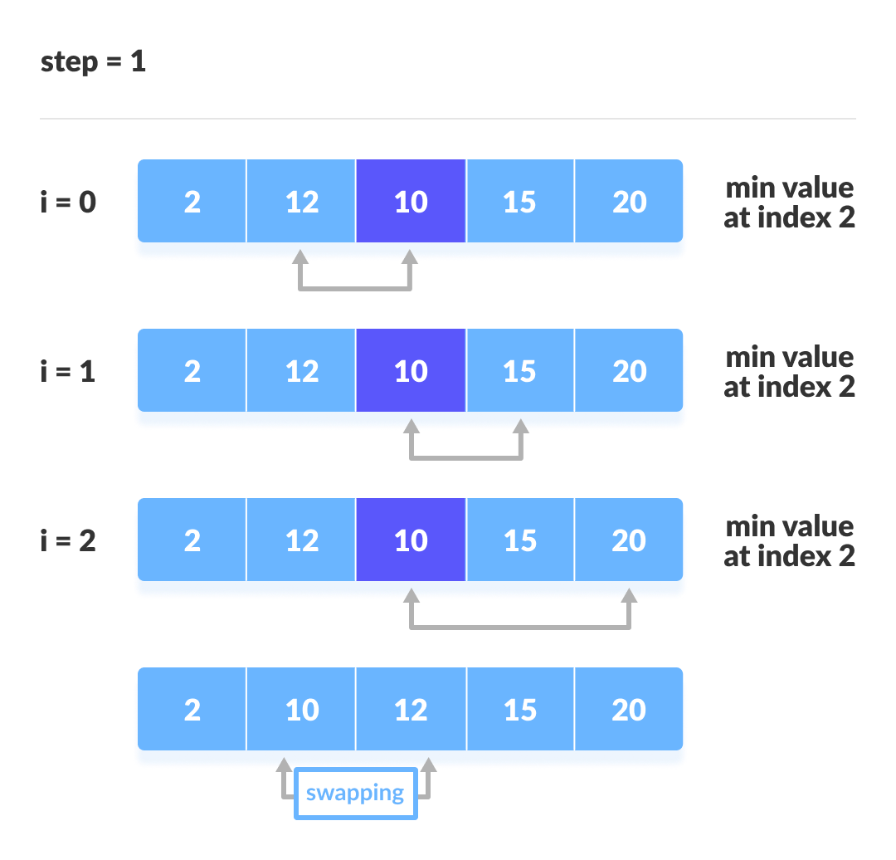
Contd…
Fig: The second iteration

Slide 19
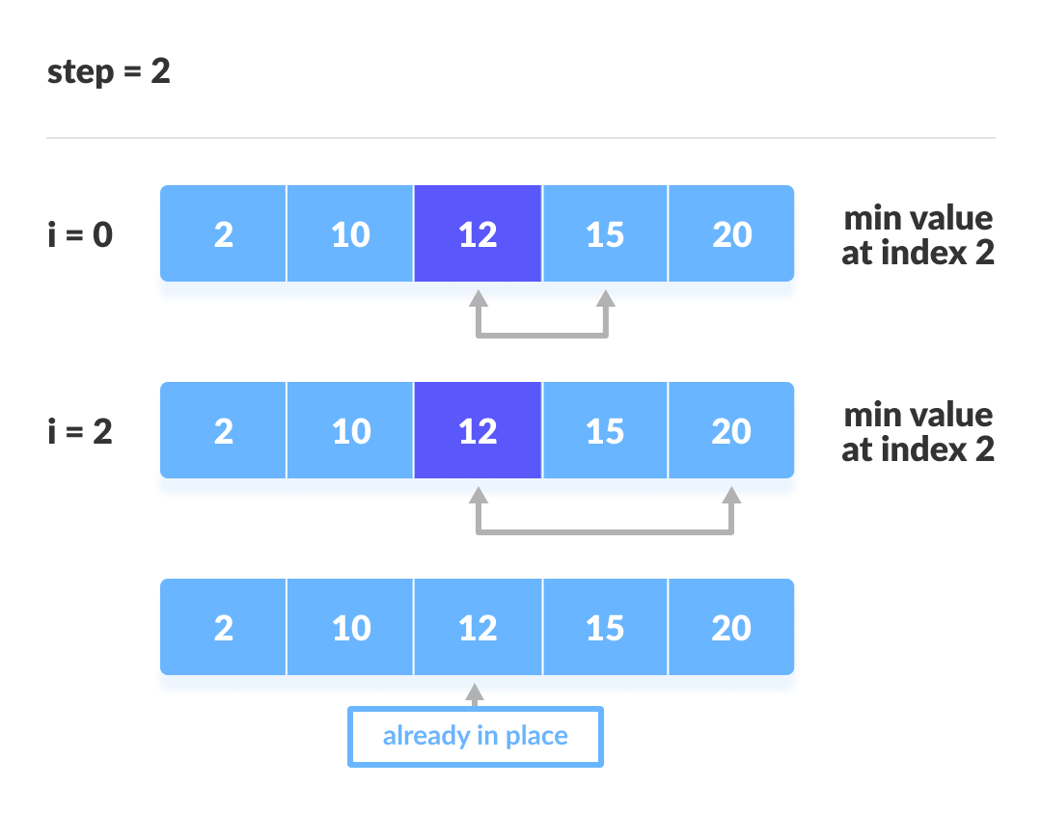
Contd…
Fig: The third iteration

Slide 20
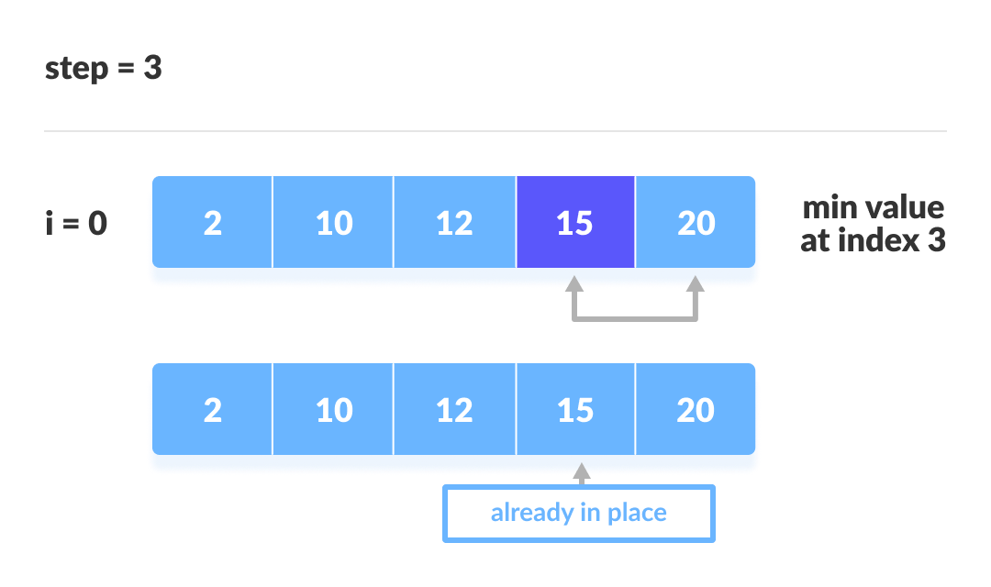
Contd…
Fig: The fourth iteration

Slide 21
Selection Sort Algorithm:
selectionSort(array, size)
repeat (size - 1) times
set the first unsorted element as the minimum
for each of the unsorted elements
if element < currentMinimum
set element as new minimum
swap minimum with first unsorted position
end selectionSort

Slide 22
Selection Sort Code in Python:
def selectionSort(array, size):
for step in range(size):
min_idx = step
for i in range(step + 1, size):
# select the minimum element in each loop
if array[i] < array[min_idx]:
min_idx = i
# put min at the correct position
(array[step], array[min_idx]) = (array[min_idx], array[step])
data = [-2, 45, 0, 11, -9]
size = len(data)
selectionSort(data, size)
print('Sorted Array in Ascending Order:')
print(data)

Slide 23
Selection Sort Complexity
Number of comparisons: (n - 1) + (n - 2) + (n - 3) + ..... + 1 = n(n - 1) / 2 .
Complexity = O(n²)
Also, we can analyse the complexity by simply observing the number of loops. There are 2 loops so the complexity is n*n = n2.
Time Complexities:
Worst Case Complexity: O(n²)
Best Case Complexity: O(n²)
Average Case Complexity: O(n²)
The time complexity of the selection sort is the same in all cases. At every step, you have to find the minimum element and put it in the right place. The minimum element is not known until the end of the array is not reached.

Slide 24
Contd…
Applications:
The selection sort is used when
a small list is to be sorted
cost of swapping does not matter
checking of all the elements is compulsory
cost of writing to a memory matters like in flash memory (number of writes/swaps is O(n) as compared to O(n²) of bubble sort)

Slide 25
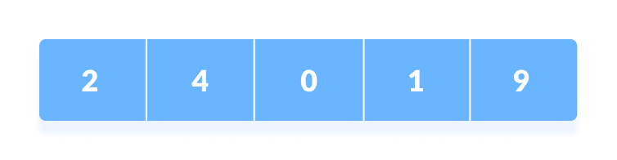
Linear Search
It is a sequential searching algorithm where we start from one end and check every element of the list until the desired element is found. It is the simplest searching algorithm.
Working:
E.g.: to search for an element k = 1 in the list below:
Fig: Array to be searched for

Slide 26
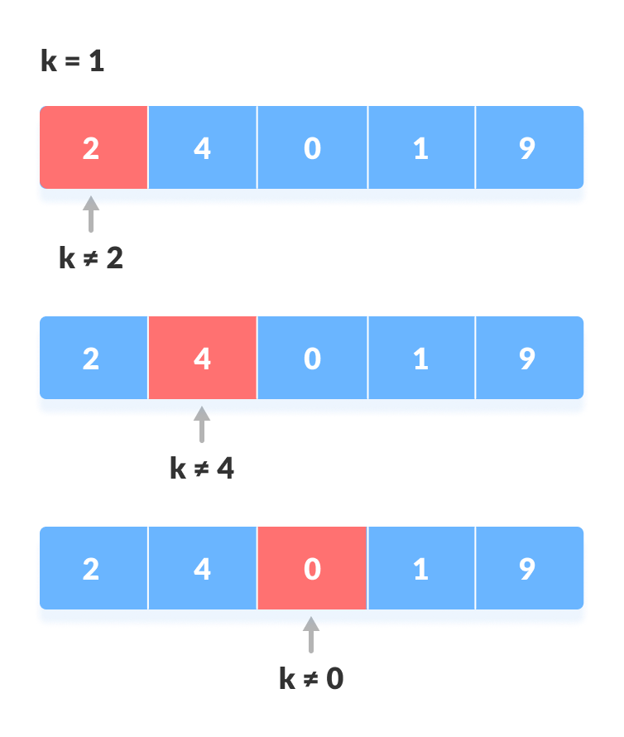
Contd… 1. Start from the first element, compare k with each element x
Fig: Compare with each element

Slide 27
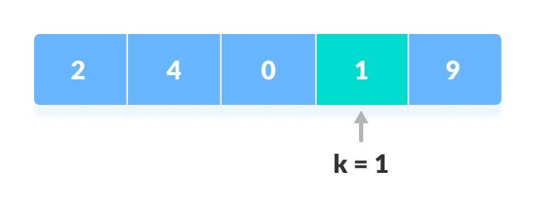
Contd… 2. If x == k, return the index.
Fig: Element found
3. Else, return not found.

Slide 28
Linear Search Algorithm:
LinearSearch(array, key)
for each item in the array
if item == value
return its index

Slide 29
Linear Search in Python:
def linearSearch(array, n, x):
# Going through array sequencially
for i in range(0, n):
if (array[i] == x):
return i
return -1
array = [2, 4, 0, 1, 9]
x = 1
n = len(array)
result = linearSearch(array, n, x)
if(result == -1):
print("Element not found")
else:
print("Element found at index: ", result)

Slide 30
Contd…
Linear Search Complexities Time Complexity: O(n) Space Complexity: O(1)
Linear Search Applications
For searching operations in smaller arrays (<100 items).

Slide 31
Binary Search
It can be implemented only on a sorted list of items. If the elements are not sorted already, we need to sort them first.
It is a searching algorithm for finding an element's position in a sorted array.
Here, the element is always searched in the middle of a portion of an array.
Working:
It can be implemented in two ways which are discussed below:
Iterative Method
Recursive Method
The recursive method follows the divide and conquer approach.

Slide 32
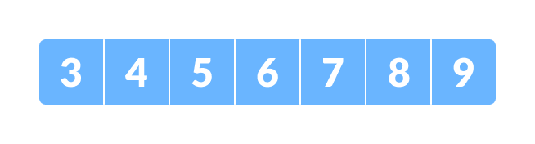
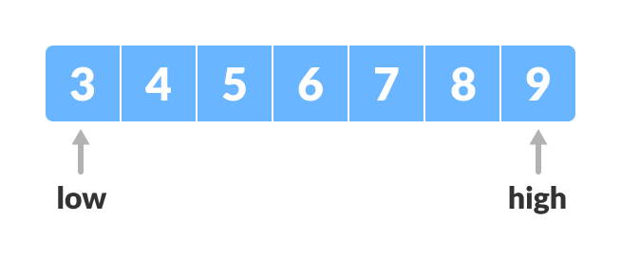
Contd… E.g.: Steps: 1. The array in which searching is to be performed is: Let x = 4 be the element to be searched.
2. Set two pointers low and high at the lowest and the highest positions respectively.

Slide 33
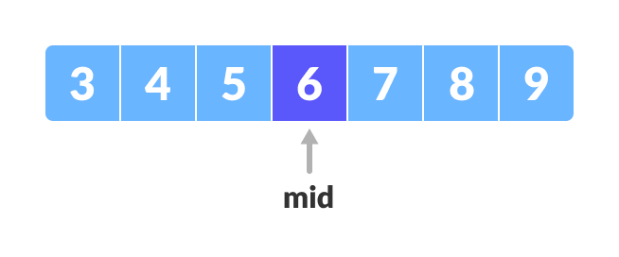
Contd… 3. Find the middle element mid of the array ie. arr[(low + high)/2] = 6.
4. If x == mid, then return mid. Else, compare the element to be searched.
5. If x > mid, compare x with the middle element of the elements on the right side of mid. This is done by setting low to low = mid + 1.
6. Else, compare x with the middle element of the elements on the left side of mid. This is done by setting high to high = mid - 1.

Slide 34
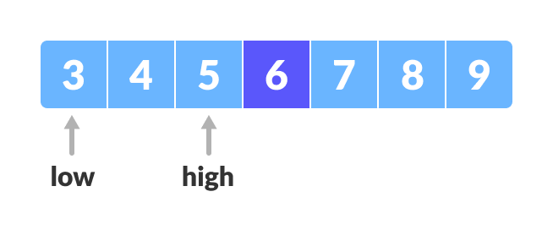
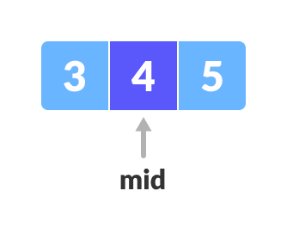
Fig: Finding mid element
Contd…
7. Repeat steps 3 to 6 until low meets high.
Fig: Mid element
8. x = 4 is found

Slide 35
Binary Search Algorithm
1. Iteration Method
do until the pointers low and high meet each other.
mid = (low + high)/2
if (x == arr[mid])
return mid
else // x is on the left side
high = mid – 1
else if (x > arr[mid]) // x is on the right side
low = mid + 1

Slide 36
Python Examples (Iterative Method):
def binarySearch(array, x, low, high):
# Repeat until the pointers low and high meet each other
while low <= high:
mid = low + (high - low)//2
if array[mid] == x:
return mid
elif array[mid] < x:
low = mid + 1
else:
high = mid - 1
return -1
array = [3, 4, 5, 6, 7, 8, 9]
x = 4
result = binarySearch(array, x, 0, len(array)-1)
if result != -1:
print("Element is present at index " + str(result))
else:
print("Not found")

Slide 37
Python Examples (Recursive Method):
def binarySearch(array, x, low, high)
if high >= low:
mid = low + (high - low)//2
# If found at mid, then return it
if array[mid] == x:
return mid
# Search the left half
elif array[mid] > x:
return binarySearch(array, x, low, mid-1)
# Search the right half
else:
return binarySearch(array, x, mid + 1, high)
else:
return -1
array = [3, 4, 5, 6, 7, 8, 9]
x = 4
result = binarySearch(array, x, 0, len(array)-1)
if result != -1:
print("Element is present at index " + str(result))
else:
print("Not found")

Slide 38
Binary Search Complexity
1. Time Complexities:
Best case complexity: O(1)
Average case complexity: O(log n)
Worst case complexity: O(log n)
2. Space Complexity:
The space complexity of the binary search is O(1).
Binary Search Applications
In libraries of Java, .Net, C++ SQL
While debugging, the binary search is used to pinpoint the place where the error happens.

